Slide 1
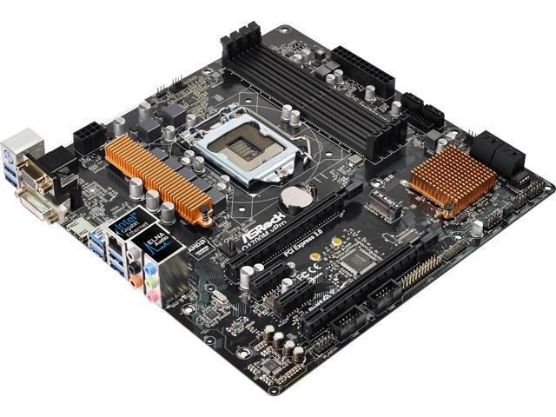
Intel AMT Activation
Secret

Slide 2
Intel AMT 6.1+
ACM - Admin Control Mode
CCM – Client Control Mode

Slide 3
Friends
CCM
Operating System
Adversaries
ACM
Operating System

Slide 4
Operating System
Activate to CCM
MEI Driver
KVM, IDER with user consent
No System Defense
OS can disable anytime

Slide 5
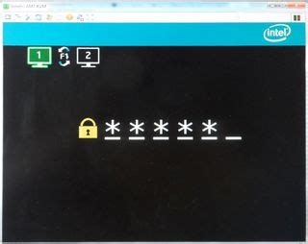
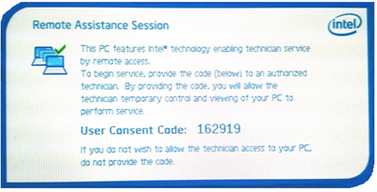

Slide 6
Operating System
Activate to ACM
KVM, IDER with optional user consent
OS can’t disable
Distrust of the OS

Slide 7
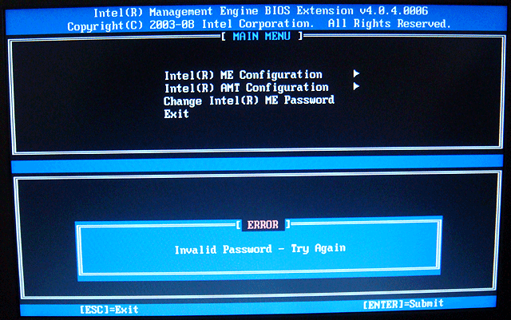
Activate to ACM – MEBx

Slide 8

Activate to ACM – USB

Slide 9

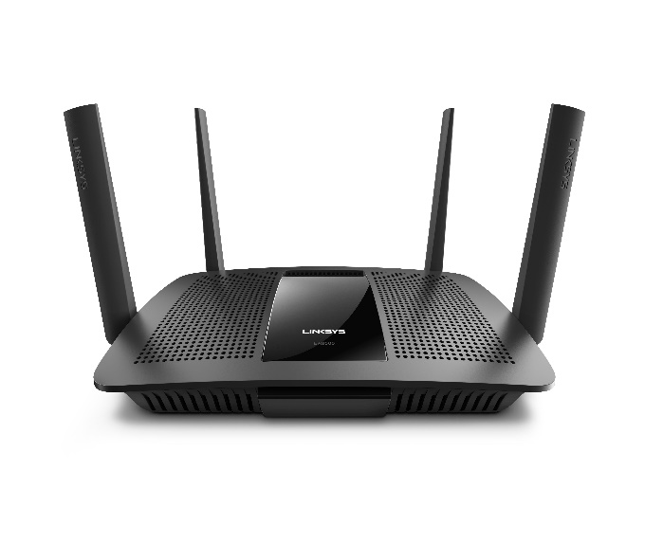
Activate to ACM – Option 15
homenetwork.org
homenetwork.org
Wired Ethernet Only

